Slide 1
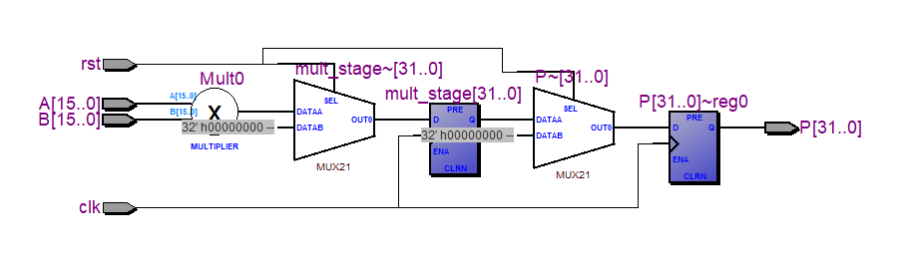
Comparative Study of Pipelined Multiplier Architectures on FPGA and Its Application in DSP Accelerators
By : Anish Das
Roll No. : 16015124005 (VLSI)
Current Objectives :
Study high-speed pipelined multiplier architectures.
Compare FPGA implementation performance.
Analyze suitability for DSP accelerator applications.
Progress Completed
Literature survey completed
Selection of five multiplier architectures
Evaluation methodology finalized
FPGA implementation flow identified
Architecture | Purpose
Pipelined Array Multiplier | Baseline architecture
Pipelined Booth Multiplier | Reduced partial products
Pipelined Wallace Tree Multiplier | High-speed reduction tree
Pipelined Dadda Multiplier | Area-optimized tree architecture
Pipelined Vedic Multiplier | Alternative high-speed architecture

Slide 2

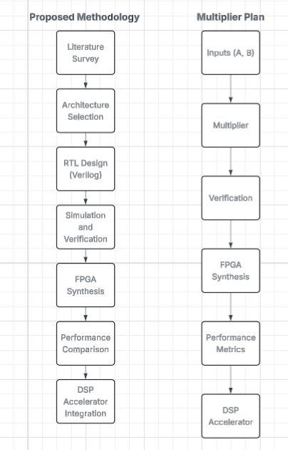
Metric | Purpose
LUT Usage | Area Analysis
Flip-Flops | Resource Utilization
Delay | Speed Analysis
Maximum Frequency (Fmax) | Throughput
Power Consumption | Efficiency
Latency | DSP Suitability
Next Steps
Implement selected multiplier architectures in Verilog.
Develop a common verification testbench.
Perform simulation and FPGA synthesis.
Compare area, speed, power, and throughput.
Select the most suitable architecture for DSP accelerator implementation.
Current Status
Project planning and architectural study completed. RTL implementation phase initiated.

